Slide 1


Nicotine Addiction
Smoking, Vaping, Snus and Nicotine Pouches
Weaving “Connecting people, projects and place together for universal well-being”.
Notes:
Good morning everyone, thank you for joining. Today I’ll be talking about nicotine addiction, giving you an update on smoking and vaping, and also discussing the increasing use of snus and nicotine pouches. My name is, and this slide set has been developed by the Irish Thoracic Society.

Slide 2
Contents
Tobacco Industry (4-5)
Understanding Nicotine Addiction, Nicotine's Devastating Impact On Teen Brain Development and Methods of Delivery (6-12)
HSBC Ireland National Report 2020 (13-18)
Why Do Kids Smoke? (19-20)
What Can Happen If You Smoke? (21-22)
Smoking Kills - Effects Of Smoking On The Body (23-29)
Tobacco Tactics (30-37)
What Is Vaping? (38-41)
Tobacco Industry - Marketing And Social Media (42-53)
Why Teens Vape - The Market Size (54-55)
E-cigarette And Smoking Use Among Adolescents In Ireland (56-58)
How Do Youth Get Vaping Products? (59-60)
Chemicals And Flavors and Health Effects (61-73)
Device Explosion (74-75)
What The Industry Is Not Telling Us? (76)
Environmental Effects of Disposable Vapes (77)
Regulation of Cigarettes and E-Cigarettes and Public Health (Tobacco Products And Nicotine Inhaling Products) Bill (78-83)
What Else Can be Vaped? What is Smokeless Tobacco and Health Effects (84-94)
Summary and Resources with Helpful Messages for Students (95-104)
2

Slide 3
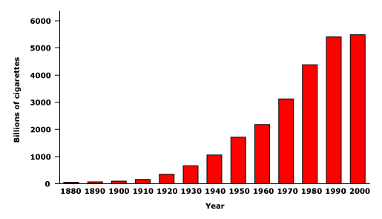
The Rise of the Tobacco Industry
3
Notes:
“This slide shows how the tobacco industry has grown—royalty, advertising, and global trade all played a role. From early ceremonial smoking to mass production, the industry has been carefully built over centuries.”

Slide 4
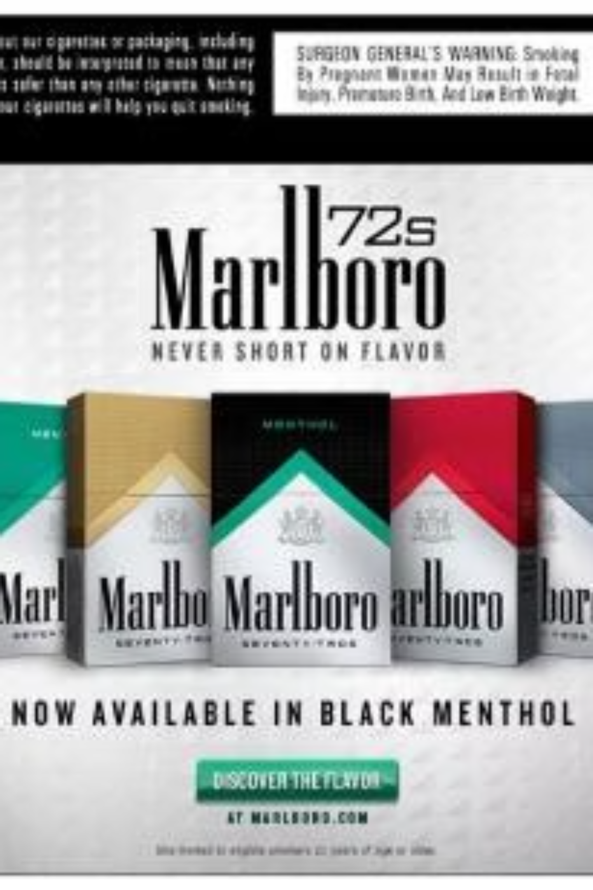
The Staggering Economics of Tobacco Industry
Understanding the financial scale of the tobacco industry provides critical context for public health interventions.
When compared to other major global markets, tobacco's profitability reveals why this industry remains so entrenched despite known health consequences.
$47B
$646B
$992B
Coca-Cola Annual Profits
Cosmetics Industry
Cigarette Industry
Annual global profits
Global beverage leader
Worldwide market value
The tobacco industry generates nearly $1 trillion in annual profits, dwarfing even major consumer goods sectors.
This immense financial power enables aggressive marketing, lobbying efforts, and the development of new nicotine delivery systems designed to maintain addiction rates across generations.
4
Notes:
To give some context, let’s look at the global profits from consumer products. Coca-Cola makes about 47 billion dollars. Cosmetics, nearly 650 billion. Cigarettes—close to a trillion dollars. This highlights the sheer scale of the tobacco industry and the financial interests at play.

Slide 5

Understanding Nicotine Addiction
A Chronic Brain Disease
"Addiction is a long-term disease where an individual has an overwhelming desire to find and use drugs, even though there are dangerous consequences."
Nicotine addiction meets all clinical criteria for substance use disorder. It is classified as a disease because it results in long-term changes in brain structure, function, and behaviors caused by drug exposure.
These neurobiological changes are not merely psychological—they represent fundamental alterations in brain chemistry and neural pathways. The compulsive drug-seeking behavior persists despite knowledge of harmful consequences, driven by physiological dependence rather than conscious choice.
Understanding addiction as a medical condition rather than a moral failing is essential for developing effective treatment approaches and reducing stigma that prevents individuals from seeking help.
5
Notes:
Addiction is more than a bad habit—it’s a disease. It’s a long-term condition in which people develop an overwhelming drive to seek and use drugs, despite harmful consequences. That’s because drug use—including nicotine—changes brain structure and function, altering behaviour.

Slide 6
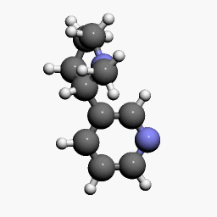
What is Nicotine?
The Nicotine Molecule
Pharmacological Profile
Classification
Psychoactive drug and powerful stimulant
Addiction Potential
Highly addictive—comparable to heroin and cocaine
Neurological Impact
Causes permanent changes in brain chemistry and reward pathways
Primary Source
Found naturally in tobacco plants and products
Commercial Use
Also employed as an insecticide to kill ants, flies, and other pests
Nicotine's dual nature as both recreational drug and agricultural poison underscores its potency. The same chemical properties that make it lethal to insects at high concentrations create powerful addiction in humans at lower doses through rapid absorption and neurological effects.
6
Notes:
Teacher Talking Points:
Nicotine is a drug that is a stimulant, meaning it raises levels of physical or psychological activity in the body, and it is toxic at high doses.
It is highly addictive since it causes changes in brain chemistry quickly and leaves the brain craving more.
it can affect maternal and fetal health during pregnancy.
nicotine exposure during adolescence may have lasting adverse effects on brain development.

Slide 7




Nicotine's Devastating Impact on Teen Brain Development
Adolescent nicotine exposure represents a particularly urgent public health concern. The developing teenage brain responds fundamentally differently to nicotine compared to adult brains, resulting in more severe and lasting consequences.
Heightened Vulnerability
Cognitive Impairment
Behavioral Changes
The adolescent brain's ongoing development makes it extraordinarily susceptible to nicotine's effects. Neural pathways are still forming, and nicotine exposure during this critical period can permanently alter brain structure.
Chronic nicotine exposure in teens leads to reduced attention span, impaired memory formation, and diminished executive function. These effects persist even after cessation.
Teen users exhibit increased reckless behavior and impulsivity. Risk assessment abilities become compromised, leading to poor decision-making across multiple life domains.
Withdrawal Intensity
Irish Youth Smoking Trends
Teenagers experience particularly severe withdrawal symptoms compared to adults:
Recent surveillance data reveals concerning patterns:
Intense, overwhelming cravings
Profound fatigue and lethargy
2019: 17% of Irish youth population reported nicotine use
Marked irritability and mood swings
2021: 18% prevalence—representing a 6% increase
Severe difficulty concentrating
Physical symptoms including headaches
The uptick during the COVID-19 pandemic period suggests that social isolation, mental health challenges, and increased online exposure to tobacco marketing may have contributed to higher youth initiation rates. This trend demands immediate intervention.
These symptoms are both more intense and longer-lasting than in adult users, making cessation exceptionally challenging for young people.
7

Slide 8

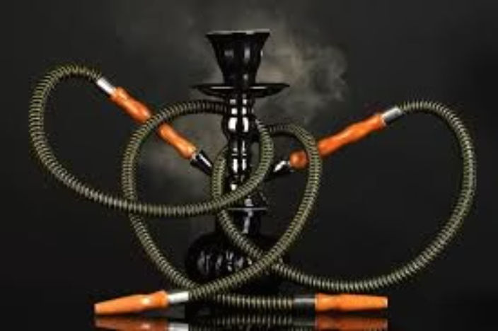
Diverse Methods of Nicotine Delivery
The tobacco industry has developed multiple delivery systems to maintain and expand their user base. Each method presents unique health risks and regulatory challenges. Understanding these varied approaches is essential for comprehensive tobacco control policy.
Cigarettes
Hookah
Chewing Tobacco
Snus
Smoked/Inhaled | Traditional combustible tobacco remains the leading cause of preventable death globally. Delivers nicotine rapidly through lung absorption along with over 7,000 toxic chemicals.
Water-Filtered Smoke | Despite popular misconceptions, hookah smoking delivers equivalent or higher nicotine doses than cigarettes. Sessions typically last 45-60 minutes, exposing users to more smoke volume.
Oral Absorption | Held between cheek and gum, releasing nicotine through oral mucosa. Contains tobacco-specific nitrosamines linked to oral, esophageal, and pancreatic cancers.
Through Mucus Membranes | Moist tobacco pouches placed under the upper lip. Popular in Scandinavia, now spreading globally. Marketed as "safer" but still highly addictive and carcinogenic.
Each delivery method is engineered to optimize nicotine absorption and addiction potential while creating distinct user experiences that appeal to different demographic groups. The proliferation of smokeless options represents the industry's adaptation to smoking restrictions and health concerns.
8

Slide 9



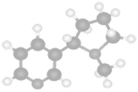
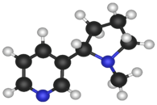
Cycle of Nicotine Addiction
tobaccopreventiontoolkit.stanford.edu
9
Notes:
Teacher Talking Points:
(Click) The cycle of nicotine addiction starts with bringing nicotine into the body. In this case it comes inhalation of cigarettes, hookah, and or e-cigs/vapes.
(Click) Nicotine enters the brain and activates the pleasure centers of the brain.
(Click) After, the level of nicotine in the body drops quickly.
(Click) This drop in nicotine levels causes the body to have a strong craving for nicotine that is satisfied by bringing more nicotine into the body.
This cycle is powered by the body’s biological reaction to nicotine and isn’t controlled by the person vaping.

Slide 10
Nicotine - Teens
Teen brain reacts differently to nicotine
Chronic nicotine exposure can, among other things, reduce attention span and increase reckless behavior
Effects are less intense and long-lasting in adults
Intense withdrawal symptoms – strong cravings, fatigue, irritability, difficulty concentrating
17% Irish population in 2019, 18% 2021 (Increased during COVID)
10
Notes:
“Teenagers are particularly vulnerable. The teen brain reacts differently to nicotine, with long-term impacts on attention, behavior, and impulse control. Withdrawal can be severe—fatigue, irritability, cravings. These effects are less intense in adults, but in teens, they can be long-lasting.”
“Looking at Ireland specifically — in 2019, about 17% of the population smoked. By 2021, during COVID, that number increased to 18%. That’s a reminder of how stress and social disruption can fuel dependence.”

Slide 11

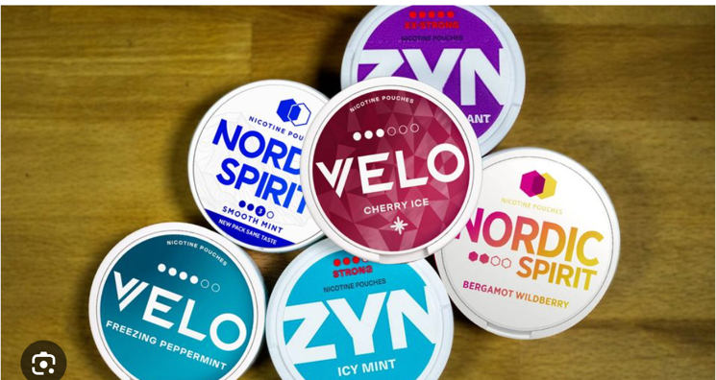
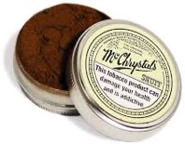
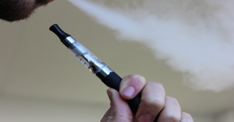
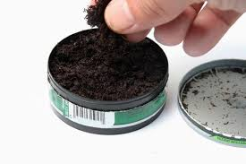

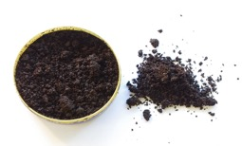
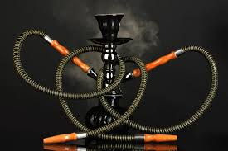
Method of Delivery
Smoked/Inhaled
Through Mucus
Membranes
CIGARETTES
Snuff
E-CIGS/ VAPES
Chew
CIGARS
Snus
HOOKAH
11
Notes:
“Nicotine isn’t just delivered by cigarettes. Here you can see the variety of products — cigars, e-cigs and vapes, hookah, chew, snuff, and snus. All of these rely on absorption through the mucus membranes, but the risks vary. The common factor is that they all deliver nicotine, and that’s what drives addiction.”
In 2025, the “new kids on the block” are nicotine pouches and we will talk about these later

Slide 12
12
Notes:
Regarding Ireland, The Health Behaviour in School-aged Children from 2020 gives great insight into national statistics

Slide 13
13

Slide 14
14
Notes:
The key points here are approximately 30% of 15-17 year olds had tried smoking

Slide 15
15
Notes:
And around 10% are current smokers, of whom most are presumably addicted to nicotine

Slide 16
16
Notes:
A worrying development also was identified, the use of e-cigarettes by both boys and girls

Slide 17
17
Notes:
With a high number also appearing to be addicted

Slide 18
18

Slide 19
19

Slide 20
20

Slide 21
Acetone—found in nail polish remover
Acetic acid—an ingredient in hair dye
Ammonia—a common household cleaner
Arsenic—used in rat poison
Benzene—found in rubber cement and gasoline
Butane—used in lighter fluid
Cadmium—active component in battery acid
Carbon monoxide—released in car exhaust fumes
Formaldehyde—embalming fluid
Hexamine—found in barbecue lighter fluid
Lead—used in batteries
Naphthalene—an ingredient in mothballs
Methanol—a main component in rocket fuel
Nicotine—used as an insecticide
Tar—material for paving roads
Toluene—used to manufacture paint
21
Notes:
“When we talk about smoking, it’s not just nicotine. Cigarette smoke contains thousands of chemicals, many of them toxic. Acetone, arsenic, carbon monoxide, formaldehyde, tar, lead — the list goes on. These are substances you’d never willingly ingest, yet smokers inhale them with every puff.”

Slide 22
Smoking Kills
Tobacco: - the only legal consumer product that harms everyone who use it - kills 50% of regular users
Most preventable cause of premature death
6000+ deaths in Ireland / year - 1 in 5 deaths
1 in 3 cancer deaths
70% smokers die from smoking
Causes of death- heart disease, stroke, cancer
Tobacco companies are aware of this- documents have identified that it is their goal to recruit at least 6000 new smokers a year to replace those who pass away
Smoking takes 10 to 15 quality years off your life
every cigarette you smoke takes 5 and a half minutes off your life
every 6 and a half seconds someone in the world dies from smoking - that’s 1.5 million people a year
most smokers (83%) regret starting smoking and say they wouldn’t smoke if they had the choice again
22
Notes:
“Tobacco is the only legal consumer product that kills half of its regular users. In Ireland, it causes over 6,000 deaths each year — that’s one in five deaths overall. It’s the leading preventable cause of premature death. Smokers lose 10 to 15 quality years of life, and every cigarette smoked costs about 5 and a half minutes of life. Most smokers regret ever starting — 83% say they wouldn’t if they had the choice again.”

Slide 23
COPD
23

Slide 24
24

Slide 25
COPD= chronic obstructive pulmonary disease- 40-50% smokers
Persistent and progressive shortness of breath, cough and wheeze mostly caused by smoking
Recurrent chest infections (bronchitis)
Emphysema- destruction of lung
Eventually on oxygen if stay smoking
Vaping also causes COPD
110000 people in Ireland have COPD, 200000 not diagnosed
25
Notes:
“Here’s an image of a lung damaged by smoking. COPD — chronic obstructive pulmonary disease — affects 40 to 50% of smokers. It causes persistent breathlessness, cough, and wheeze. Infections, emphysema, and eventually oxygen dependence are common. Importantly, vaping is also now linked with COPD. In Ireland, about 110,000 people are diagnosed, but it’s estimated another 200,000 are undiagnosed.”

Slide 26
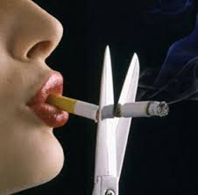
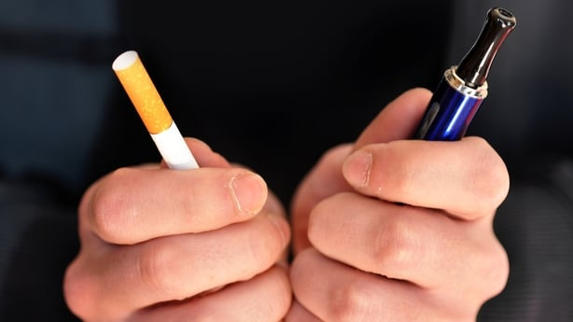
Smoking is a disease – not a life-style choice
Tobacco (nicotine) dependence is a chronic relapsing disease
WHO (ICD-10) classification
Smokers need help to quit - 70% want to quit
Relapse is common - many attempts before success
2 in 3 smokers try to quit every year - fewer than 10% succeed without assistance
Treatment works
26
Notes:
“Nicotine dependence is classified by the WHO as a chronic, relapsing disease. It’s not a lifestyle choice. Most smokers want to quit — around 70% — but relapse is common. Two-thirds of smokers try every year, and fewer than 10% succeed without help. But treatment works. With licensed nicotine replacement therapies, used for at least three months, quit rates are much higher.”

Slide 27
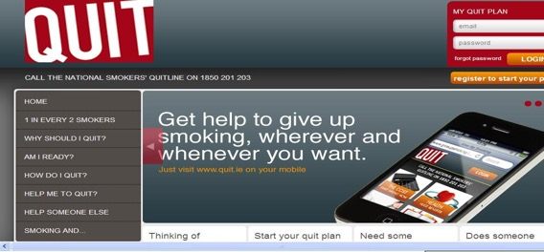
HSE website: www.quit.ie
27
Notes:
“For anyone ready to quit, the HSE website — quit.ie — is an excellent starting point. It provides resources, support, and connections to treatment programs.”

Slide 28
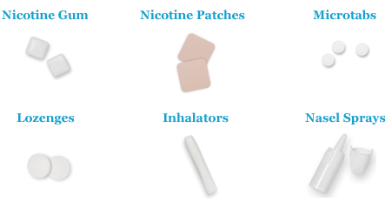
Regulated Licensed Nicotine Replacement Therapy- 2 modalities for at least 3 months
28
Notes:
There are a number of safe and regulated nicotine products proven to double your odds of giving up cigarettes and it is recommended that you try patches (work for 24 hours) and a short acting product (for instance chewing gum, lozengers and inalators) to help with cravings during the day for at least 3 months.
When you sign up to Quit.ie you receive free nicotine replacement and it is cheaper than cigarettes.

Slide 29

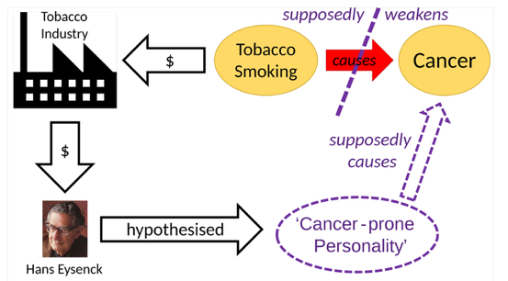
Tobacco Tactics : create doubt, identify advertise and pay scientists to generate pro-tobacco research
29
Notes:
This diagram demonstates a mechanism of creating doubt regarding the link between smoking and cancer.
Cigarettes generate income for the tobacco companies who pay so called experts to publish research suggesting that for instance the patients cancer prone personality or genetics are a cause of cancer not necessarily the cigarettes

Slide 30
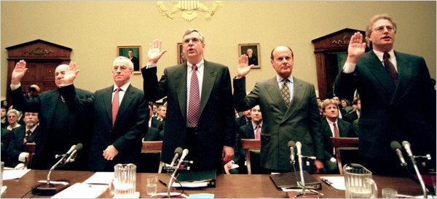

RICO Case
tobaccopreventiontoolkit.stanford.edu
From left, Laurence Tisch, of Loews; Geoffrey Bible, Philip Morris; Vincent Gierer, UST; Steven Goldstone, RJR Nabisco; and Nicholas Brooks, Brown & Williamson, at a 1998 House hearing. Credit Jessica Persson/Agence France-Presse
Vital to get teenagers smoking before age 18
If a young adult reaches 21 without starting smoking, it is very unlikely they will become regular smokers
30
Notes:
“In the US, the Department of Justice sued tobacco companies under racketeering laws in 1999. The case exposed a decades-long conspiracy to mislead the public about the risks of smoking. In 2006, the court ruled the companies had violated the law. It confirmed what health advocates had long argued: the tobacco industry deliberately deceived the public.”
Again
Vital to get teenagers smoking before age 18
If a young adult reaches 21 without starting smoking, it is very unlikely they will become regular smokers

Slide 31

Behind the Scenes
tobaccopreventiontoolkit.stanford.edu
“Today's teen-ager is tomorrow's potential regular customer and the overwhelming majority of smokers first begin to smoke while in their teens. . .”
-March 31, 1981 Philip Morris Report (1)
“At least a part of the success of Marlboro Red during its most rapid growth period was because it became the brand of choice among teenagers who then stuck with it as they grew older. "
-March 31, 1981 Philip Morris Report (2)
31
Notes:
Teacher Talking Points:
Let’s look at some actual quotes from the tobacco industry that shows how the really see people your age.
(Click) Today's teen-ager is tomorrow's potential regular customer and the overwhelming majority of smokers first begin to smoke while in their teens.
(Click) At least a part of the success of Marlboro Red during its most rapid growth period was because it became the brand of choice among teenagers who then stuck with it as they grew older.

Slide 32
More Quotes from the Industry
tobaccopreventiontoolkit.stanford.edu
“The ability to attract new smokers and develop them into a young adult franchise is key to brand development.”
-1999 Philip Morris Report (3)
“They represent tomorrow's cigarette business. . . As this 14-24 age group matures, they will account for a key share of the total cigarette volume -- for at least the next 25 years.”
-September 30, 1974 R.J. Reynolds Tobacco Co (4)
32
Notes:
Teacher Talking Points:
(Click) The ability to attract new smokers and develop them into a young adult franchise is key to brand development.
(Click) They represent tomorrow's cigarette business. . . As this 14-24 age group matures, they will account for a key share of the total cigarette volume -- for at least the next 25 years.
How do you feel about you and others your age being talked about in this way?

Slide 33
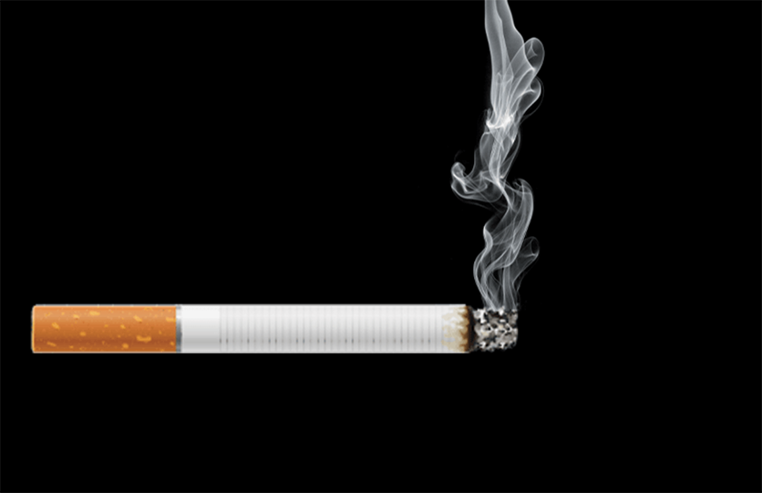
Increasing Addictiveness
Flavorings
Added flavors mask the harshness of smoke and make products more appealing to new users, especially young people
Bronchodilators
Added chemicals expand the lungs’ airways, making it easier for tobacco smoke to pass into the lungs
?
Increased Nicotine
Tobacco companies control the delivery and amount of nicotine to ensure addiction
Sugars & Acetaldehyde
Added sugars make tobacco smoke easier to inhale and form acetaldehyde, which enhances nicotine’s addictive effects
?
Menthol
Menthol cools and numbs the throat to reduce irritation and make smoke feel smoother
Nicotine Salts
Behave like ammonia compounds, but also hide the harshness of nicotine
Ammonia Compounds
Adding ammonia compounds increases the speed with which nicotine hits the brain
33
Notes:
Teacher Talking Points
There are several features of cigarettes that are designed to make them as addictive as possible.
(Click) The nicotine levels in cigarettes are controlled by the tobacco companies. This is true of both cigarettes and e-cigs/vapes.
(Click) Menthol is a substance found in mint plants that cools and numbs the throat to reduce irritation and makes smoking feel smoother, making it easier to keep smoking.
(Click) Added flavors mask the harshness of smoke and make products more appealing to new users. Flavors are still being used in new tobacco products like in the e-liquid used in e-cigs/vapes. Flavors are found to be especially appealing to young people.
(Click) Ammonia or ammonia compounds are added to cigarettes, which increase the speed at which nicotine is delivered to the brain.
(Click) Bronchodilators are chemicals that expand the lungs’ airways, making it easier for tobacco smoke to pass into the lungs, ultimately delivering more nicotine to the brain.
(Click) Adding sugars makes tobacco smoke easier to inhale and form acetaldehyde, which enhances nicotine’s addictive effects.
(Click) Don’t forget that this design applies to pod-based e-cigarettes as well. That shouldn’t surprise you though because e-cigarette companies followed the playbook from cigarette companies.
Some ingredients are still being identified in e-cigarettes, such as bronchodilators, sugars and acetaldehyde. Researchers are catching up with studying these recent devices.
(Click) Nicotine salts in pod-based e-cigarettes act like ammonia compounds but also hide the harshness of nicotine.
Reference: Campaign for Tobacco-Free Kids. (2014). Designed for Addiction: How the Tobacco Industry Has Made Cigarettes More Addictive, More Attractive to Kids and Even More Deadly.

Slide 34


Who is going to replace the old smokers?
tobaccopreventiontoolkit.stanford.edu
34
Notes:
Teacher Talking Points:
The e-cigarette/vape pen industry knows that many of their customers are getting older and need to be replaced with new customers so they can make more profits.
Who do you think they see as the ideal customer?

Slide 35
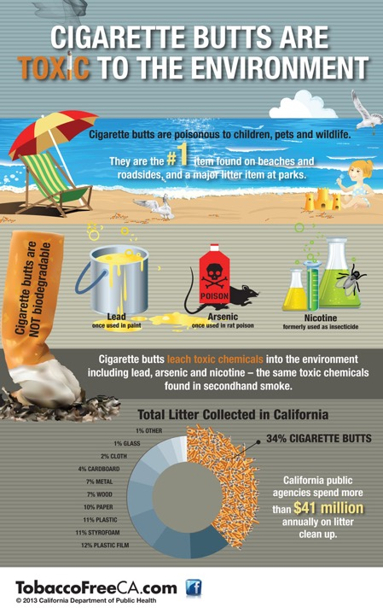
35
Notes:
Despite widespread informstion, cigarette butts do not simply “dissolve”

Slide 36
Electronic Cigarettes
E-Cigarette/Vape Pen Liquid Ingredients
Propylene Glycol
Vegetable Glycerin
Nicotine
Flavoring Chemicals
36
Notes:
Teacher Talking Points:
This is E-liquid, or sometimes called e-juice
This is what is put into the e-cigarette/vape pen device and often contains flavors and nicotine
There are over 7,000 flavors of e-liquid that are made with flavoring chemicals and may or may not contain nicotine
The e-juice is heated inside the device and creates the flavors and aerosol that is inhaled into the body and out into the air

Slide 37
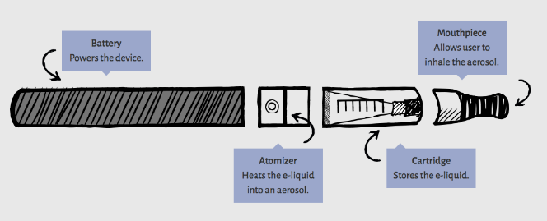
What Is Vaping?
Vaping is the act of inhaling and exhaling the aerosol, often referred to as “vapor,” produced by an e-cigarette or similar device. Components include:
  Cartridge or reservoir to hold a e-liquid
  Heating element (atomizer)
  Power source (battery)
  Mouthpiece to inhale
37
37
Notes:
Vaping is inhaling an aerosol using an e-cigarette or similar device. In most devices, puffing activates the heating component, which vaporizes the liquid or oil in the cartridge. The person then inhales and exhales the resulting aerosol.
What’s good about e-cigarettes is that they do not produce tobacco smoke, which is the most dangerous component of smoked cigarettes.
But the term vaping is misleading because these devices don’t produce pure water vapor. The aerosol actually consists of many chemicals and fine particles, many of which are toxic and dangerous, and seep deep into the lungs and bloodstream when vaping.

Slide 38


It’s an Aerosol, Not a Vapor
38
Notes:
Teacher Talking Points:
E-cigarettes/vape pens allow the user to make large clouds that many think are just water vapor
In reality the ‘cloud’ is a mixture of many different chemicals that were either present in the e-liquid before or produced during the heating process (click)
A vapor is a chemical that has evaporated
An aerosol is a mixture of liquid particles suspended in a gas and can contain many chemicals
Instead of just mixing with the air like a pure gas, aerosols can leave drops behind.

Slide 39
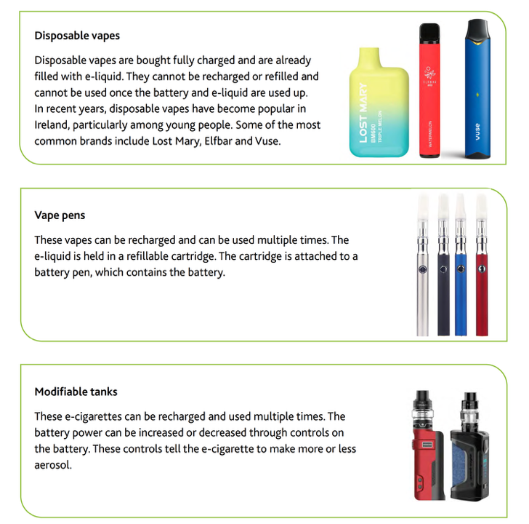
39
Notes:
At present there are three different type of devices that are used as vapes…. Describe each type.
Of note the tobacco companies are again using tactics to get around any ban on disposable vapes by creating similar devices that last 2 weeks and are not therefore disposable.

Slide 40
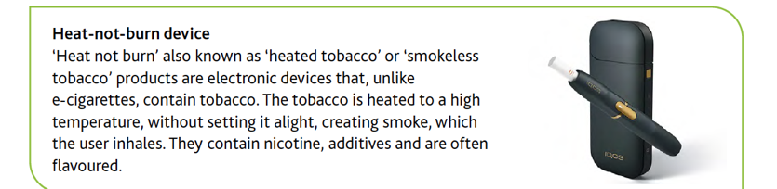
Heated tobacco device
40
Notes:
Unlike e-cigarettes heated tobacco products contain tobacco not nicotine. Tobacco companies such as makers of Malboro are investing billions and aggressively advertising these globally with unproven claims of safety.

Slide 41
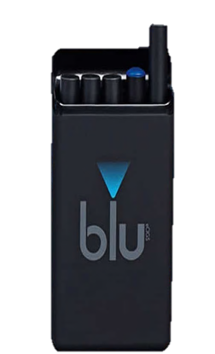
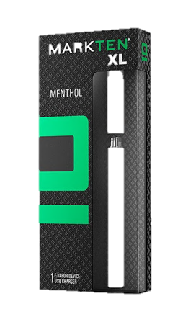
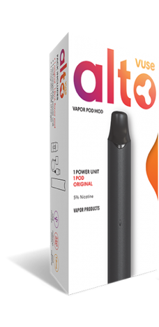
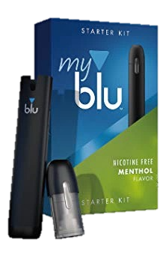
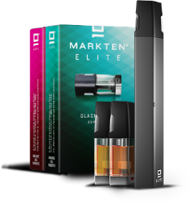
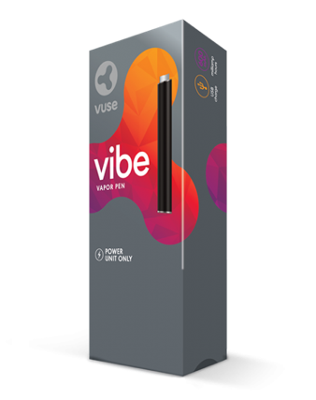
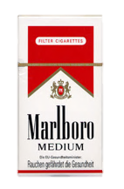


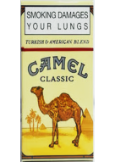
The Usual Suspects
tobaccopreventiontoolkit.stanford.edu
41
Notes:
Teacher Talking Points:
Some of the brands behind these new products are actually the same corporations that produced traditional cigarettes.
The company that sells Newport sells Blu, Marlboro used to sell Mark Ten, and Camel sells Vuse. They have kept up with products like JUUL, by releasing their own pod-based e-cigarettes (click).
Basically, these Big Tobacco corporations are replacing their old cigarette customers with new customers around your age that they hope to keep for a lifetime by promoting a new product.

Slide 42
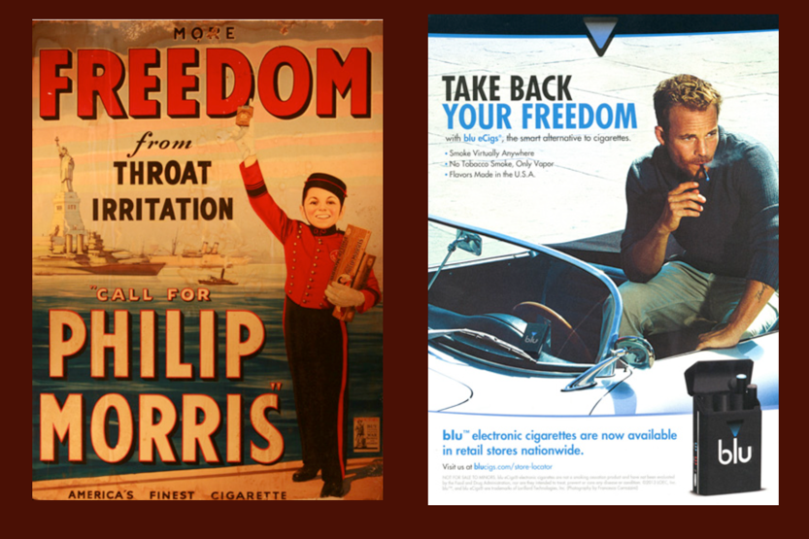
Cigarette vs. E-Cig/Vape Ads
tobaccopreventiontoolkit.stanford.edu
1941, Philip Morris
2013, Blu
42
Notes:
Ads are very similar to original cigarette ads

Slide 43

Cigarette vs. E-Cig/Vape Ads
tobaccopreventiontoolkit.stanford.edu
2015, Juul
43
1989, Capri

Slide 44

Cigarette vs. E-Cig/Vape Ads
tobaccopreventiontoolkit.stanford.edu
2018, Juul
44
2000, Camel

Slide 45

Cigarette vs. E-Cig/Vape Ads
tobaccopreventiontoolkit.stanford.edu
NJOY
45
Newport

Slide 46
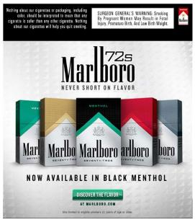
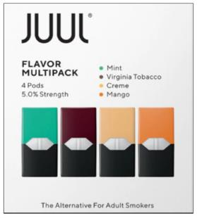
Tobacco + e-cigarettes: packaging
46
Notes:
Some vaping companies, in this case JUUL, design the packaging of their products in a way that closely resembles popular cigarette brand designs.

Slide 47
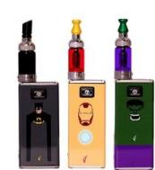
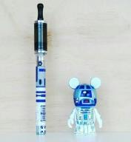



Youth-friendly designs and flavors
4 out of 5 kids who have used tobacco products
started with a flavored product.
47
Notes:
These are some examples of vaping products with kid-friendly designs.
Vaping products come in a broad array of unmistakably child-friendly flavors, often packaged to resemble well-known candy products.
There are literally thousands of flavors available, many with very delicious names including mango, apple pie, milk chocolate, peanut butter cup, as well as “Unicorn Puke” and “Zombie Juice.”
Why are flavors so important?
They mask the harsh taste of nicotine and other chemicals, making it easier to inhale the aerosol.
Sweet, fun flavors also appeal to kids because they are associated with positive childhood experiences, like parties and treats.
Kids assume the product is less harmful because of the flavorings.
Proponents of allowing flavored e-cigarettes argue that they make it more appealing for cigarette smokers to switch to vaping and that if flavors were banned, adult smokers will be less likely to switch and quit smoking. But recent research contradicts this. Studies of e-cigarette users find that, compared with older adults, adolescents and young adults are more than three times as likely to say they use fruit- and candy-flavored e-cigarettes.
_____________
Sources:
Leventhal et al. (2019). Flavored e-cigarette use and progression of vaping in adolescents. https://pediatrics.aappublications.org/content/144/5/e20190789
Soneji et al. (2019). Use of flavored e-cigarettes among adolescents, young adults, and older adults: Findings from the population assessment for tobacco and health study. https://www.ncbi.nlm.nih.gov/pubmed/30857471
Zare et al. (2018). A systematic review of consumer preference for e-cigarette attributes: Flavor, nicotine strength, and type. https://journals.plos.org/plosone/article?id=10.1371/journal.pone.0194145

Slide 48



Social media marketing- not tv/print
48
Notes:
NB:
In its first three years on the market, JUUL didn’t bother advertising on TV, radio or in magazine outlets as other vaping companies did because these media sources are all but ignored by kids.
Instead, it went directly to where kids spend most of their time – social media.
JUUL used themes that worked well in the past for the cigarette industry, including ads associating the product with pleasure/relaxation, socialization/romance, style/identity, freedom, rebellion and satisfaction.
The ads prominently featured sweet and fruity flavors, as well as young, cool-looking people, mostly having a great time.
The company also employed known social media influencers as brand ambassadors.
They used numerous hashtags which distributed JUUL’s promotion to a wide audience, including hashtags not directly related to their product, such as #style, #design, #electronics, #technology, #smart and #gadget, broadening their reach and influence even among those not specifically searching for JUUL-related posts.
Although the focus of attention has been on JUUL for its marketing tactics, many other vaping companies used cartoons and other child-appealing strategies in their social media marketing efforts.

Slide 49
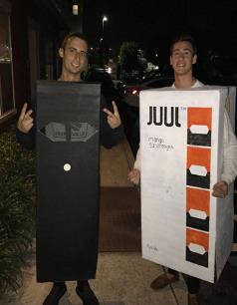
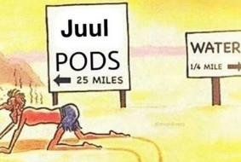
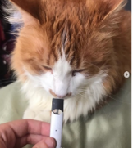



Social media posts and JUUL
49
Notes:
The federal government recently began to crack down on JUUL’s marketing practices so JUUL removed themselves from social media platforms like Instagram. But kids still post images promoting their product. These pictures found on social media are examples of JUUL’s widespread popularity.
A recent study found a proliferation of JUUL-related content on Instagram, with over half of the posts (55%) containing youth-related content.
In fact, since JUUL closed its Instagram account, the volume of JUUL-related content on the platform has only increased – it’s actually doubled -- according to a Stanford University study.
_____________
Source: Czaplicki et al. (2019). Characterizing JUUL-related posts on Instagram. https://tobaccocontrol.bmj.com/content/early/2019/05/08/tobaccocontrol-2018-054824

Slide 50

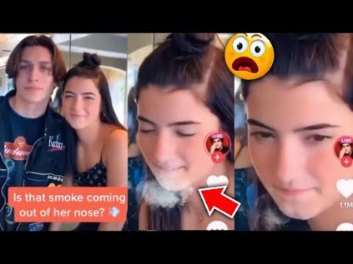
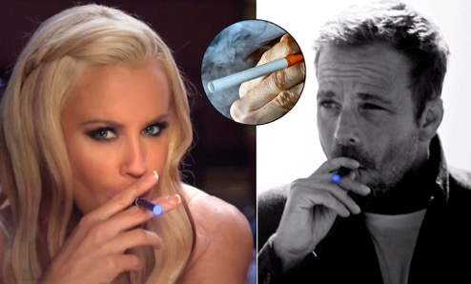
50
Notes:
Influencers are being paid to use E-cigarettes

Slide 51

Vaping videos feature prominently on platforms like TikTok where the hashtag '#vape' has more than ten billion views, suggesting social media is playing an important role in the promotion of vaping here.
51

Slide 52

Buying Your Attention
tobaccopreventiontoolkit.stanford.edu
$800
Million
52
Notes:
Teacher Talking Points:
Companies spend a lot of money figuring out how to get the attention of the people who they would like to buy their product.
E-cigarette companies are no different. In 2018, e-cig/vape companies spent $110 million on advertising for print, radio, television, Internet and outdoors.
Why do you think that companies are willing to spend so much money on advertising?
Reference: https://pubmed.ncbi.nlm.nih.gov/32108086/
Image Credit: Canva.com

Slide 53
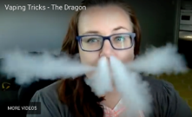
Why teens vape
Curiosity (55%)
Friend or family member vapes (31%)
Flavors (22%)
Vaping tricks (21%)
Less harmful than other tobacco products (16%)
Discreet, can be used anywhere (14%)
Peer pressure (11%)
To try to quit other tobacco products (6%)
Easier to get than other tobacco products (5%)
Famous people use them (4%)
Vape smoke is not just water- multiple harmful chemicals
Source: CDC, 2019
8% Because I am hooked- have to have it
More people get addicted to vaping than traditional cigarettes- higher nicotine content
53
Notes:
A 2019 national survey of middle and high school students who reported using e-cigarettes found that the most commonly selected reasons for use were:
Curiosity (55%)
Friend or family member use (31%)
Flavors: “such as mint, candy, fruit, or chocolate” (22%)
Vaping tricks (21%) - the picture is a young girl doing “The Dragon,” a popular vaping trick
_____________
Source: Wang et al. (2019). Tobacco product use and associated factors among middle and high school students — United States, 2019.
https://www.cdc.gov/mmwr/volumes/68/ss/pdfs/ss6812a1-H.pdf

Slide 54
Market size
In 2025, the revenue in the E-Cigarettes market in Ireland is projected to reach US$131.0m.
It is anticipated that the market will experience an annual growth rate of 2.58% (CAGR 2025-2030).
When compared globally, United States leads in terms of revenue generation, with an estimated revenue of US$9bn in 2025.
In Ireland, the per-person revenue in the E-Cigarettes market is expected to be US$29.17 in 2025, taking into account the total population figures.
Ireland's e-cigarette market is experiencing a surge in popularity as more smokers turn to vaping as a healthier alternative
Global 1.037 trillion dollars by 2037
54

Slide 55
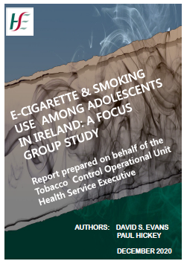
55

Slide 56
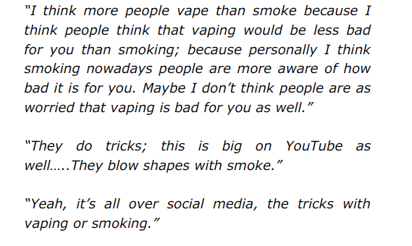
E-Cigarette and Smoking Use Among Adolescents In Ireland
56
Notes:
Quotes from students

Slide 57
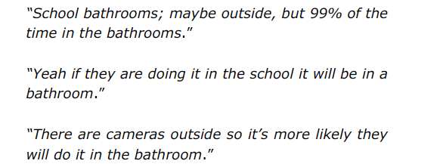
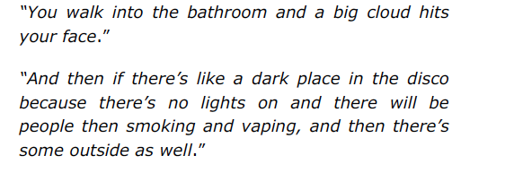
Where
57

Slide 58
How do youth get vaping products?
Sources of e-cigarettes among students who vaped in the past 30 days (2018)
Friend
Vape shop
Family member
Gas station/convenience store
Person other than family member or friend
Online
59%
17%
13%
10%
9%
6%
U.S. law now prohibits the sale of tobacco products, including e-cigarettes, to anyone under age 21
58
Notes:
It’s relatively easy for youth to get vape products despite efforts to reduce access among young people.
Selling any tobacco product, including e-cigarettes, to anyone under age 21 is illegal according to federal law, as of December 2019. However, clerks at tobacco shops, vape stores, gas stations and convenience stores do not always follow the law.
A recent national survey of middle and high school students found that, among those who reported using e-cigarettes in the past 30 days, 59% got them from a friend, 17% from a vape shop, 13% from a family member, 10% from a gas station or convenience store and 9% from someone who is not a family member or friend. About 6% got them online.
Although few kids buy them online, another study found that doing so is pretty easy with a 90% success rate, since website age gates are easy to get around.
_____________
Sources:
Liu et al. (2019). Youth access to tobacco products in the United States, 2016-2018. https://www.ncbi.nlm.nih.gov/pubmed/31745494
Williams et al. (2015). Electronic cigarette sales to minors via the internet. https://www.ncbi.nlm.nih.gov/pubmed/25730697

Slide 59
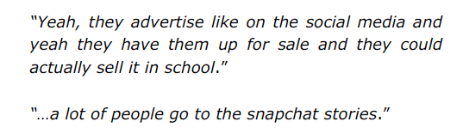


Where students buy them
59

Slide 60



Effects on Health
tobaccopreventiontoolkit.stanford.edu
60
Notes:
Teacher Talking Points:
Along with the harms from nicotine on its own, we know there are other health risks from these products.

Slide 61
Are E-cigarettes safer- especially compared to standard cigarettes?
Nicotine
Other chemicals (propylene glycol=antifreeze)
Flavourings (cinnamon flavour can burn through plastic)
Highly addictive
Presumptions that they are safe, safer than standard cigarettes and help with smoking cessation- all not proven
Only was to answer long term safety is to monitor teenagers who start vaping and vape alone without smoking cigarettes for 30 years
61

Slide 62
Where Else Can You Find These Chemicals?
Propylene glycol
→Antifreeze
Acetone
→Nail Polish Remover
Ethylbenzene
→Paints, Pesticides
Formaldehyde
→Embalming
Nicotine
→Cigarettes
Rubidium
→Fireworks
62
Notes:
Teacher Talking Points:
Although the chemicals that have been found in e-cig aerosols might seem unrecognizable, you are familiar with other places some of those same chemicals can be found.
(click) For example, Propylene glycol can be found in antifreeze products or also used to winterize plumbing systems
(click) Acetone is commonly found in nail polish remover and as a paint thinner
(click) Ethylbenzene is often used to make other chemicals. It’s also found in other products, including pesticides, synthetic rubber, varnishes paints, and inks
(click) Formaldehyde based solutions are also used in embalming to disinfect and temporarily preserve human and animal remains
(click) Maybe the most important ingredient here is nicotine. Nicotine is a drug that's highly addictive in moderate doses, and is the reason why smokers smoke even after they start getting sick. Of course, in high doses, it's a poison--in fact, plants make it to keep insects from eating them. It's a funny drug that has a lot of effects, but mostly it's an upper.
(click) Rubidium is a chemical that can be used to give fireworks their bright colors
So now that you know that e-cigarettes/vape pens produce aerosol, and that those aerosols contain harmful chemicals, how would you describe e-cig clouds to someone who says they are just water vapor?

Slide 63

Cytotoxic Flavors
tobaccopreventiontoolkit.stanford.edu
Cinnamon flavors may contain:
Cinnamaldehyde, 2-Methoxycinnamaldehyde
Cherry flavors may contain:
Benzaldehyde
63
Notes:
Teacher Talking Points:
When a chemical is cytotoxic it means that the chemical to toxic to living cells in your body.
Various cinnamon flavors contain cytotoxic compounds.
The cherry flavor, benzaldehyde, is cytotoxic as well.

Slide 64
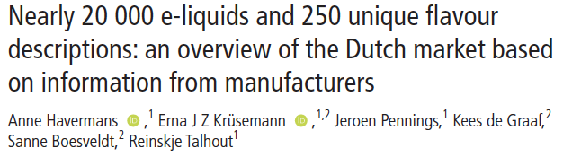
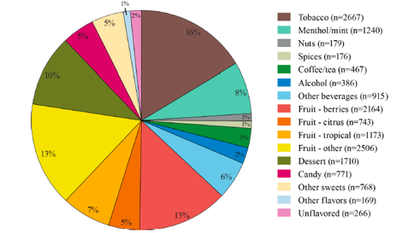

64
Notes:
This Dutch study highlighted the prevalence of flavoured e cigarettes

Slide 65
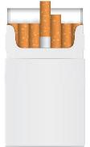



The Nicotine “arms race”
1 pack of Cigarettes
≈ 20 mg of inhaled nicotine
1 JUUL pod
≈ 41.3 mg of nicotine
1 PHIX pod
≈ 75 mg of nicotine
1 Suorin pod
≈ 90 mg of nicotine
= 20
Cigarettes
= 44
Cigarettes
= 75
Cigarettes
= 90
Cigarettes
Source: Science News for Students
65
Notes:
This compares the concentrations of nicotine in pods as compared to traditional cigarettes. The newer vape devices hold more nicotine than most traditional cigarettes. For example, each JUUL pod contains 41.3 milligrams of nicotine which is equal to smoking 26 to 40 conventional cigarettes (depending on how they are puffed).
Other companies on the market are providing even higher concentrations of nicotine as pictured here with PHIX and Suorin.
_____________
Source: Raloff, J. (2019, December 19). Today’s nico-teen addicts: What role does ‘juuling’ play? https://www.sciencenewsforstudents.org/article/juul-e-cig-vaping-nicotine-teens-addiction

Slide 66

How Much is That?
A
A
5% strength of what?
How much is 5%?
41.3 mg!
They
want
you
to
be
confused!
66
Notes:
Teacher Talking Points:
The two most common ways the pod-based industry represents the amount of nicotine in e-juice is in milligrams per milliliter (mg/mL) or percentage of nicotine by weight (%).
The labeling of nicotine content is inconsistent, sometimes represented in milligrams or milliliters, and sometimes they may not be labeled at all. (Click) From a show of hands, how many of you are confused so far? (Click) Well, how might your confusion benefit the pod-based industry?
Responses to 2nd question could include: 1. Underestimates the device’s nicotine content, making it seem safe to use 2. People would feel more inclined to try these products 3. Feel more comfortable continuing to use this product
A higher value means there is more nicotine, but 5% on these boxes is misleading. 5% is a small number and it just says “5% strength.”
(Click) 5% strength of what? Exactly how much is 5%?
How might this marketing strategy of using “5% strength” on the packaging manipulate and mislead young people?
Responses could include: 1. no mention of nicotine may give young people the impression that it is safe 2. using a smaller number like 5 instead of 41.3mg once again downplays the amount of nicotine present
(Click) Remember, a JUUL pod contains 41.3 milligrams of nicotine.
Images:
http://rizvape.com/wp-content/uploads/2018/05/starter-kit.png
https://www.elementvape.com/suorin-drop-ultra-portable-system
https://cdn3.volusion.com/pnhwe.bmygz/v/vspfiles/photos/MLV-PHX20-2.jpg?1514889651
https://phixvapor.com/products/deluxe-bundle-set-customer-appreciation
https://progressivegrocer.com/myblu-intense-nicotine-salt-liquidpods-vaping-device-refills
https://www.ctcwholesalers.co.uk/ecigarettes/capsules-and-pods/my-blu-liquid-pod-cherry-crush-8mg-2-pack
https://media.4rgos.it/s/Argos/8197410_R_SET?$Main768$&w=620&h=620
https://www.majorleaguevapers.com/pub/media/catalog/product/cache/c687aa7517cf01e65c009f6943c2b1e9/b/u/butterscotch-packaging_2048x_da85aa26-eb89-4eac-b1fe-fa2d39928850_720x1000_2.png
https://www.avtxwholesale.com/web/image/product.template/15998/image?unique=d9e65bc
https://vaporsplanet.com/wp-content/uploads/2018/11/SMOK-Novo-Pods.png
https://www.ievapor.com/images/LoKey-V2-Variable-Voltage-Battery.jpg

Slide 67







Cigs in a Pod
tobaccopreventiontoolkit.stanford.edu
1 Pack of Cigarettes
≈20 mg of nicotine
1 JUUL pod
≈41.3 mg of nicotine
1 Puff bar
≈50 mg of nicotine
1 Suorin pod
≈90 mg of nicotine
ALL PODS CONTAIN HIGH LEVELS OF NICOTINE
=20
CIGARETTES
≈41
CIGARETTES
≈50
CIGARETTES
≈90
CIGARETTES
67
Notes:
Teacher Talking Points:
If you don’t know, a standard pack of cigarettes contains 20 cigarettes (click). There is 1 mg of nicotine absorption per cigarette, so about 20 milligrams of nicotine delivered to the body from a whole pack of cigarettes.
Unlike other e-juices which may or may not contain nicotine, ALL salt-based e-juice contains nicotine!
According to JUUL Labs, one JUUL pod contains 41.3 milligrams of nicotine. This is equal to the amount of nicotine you’ll find in about 40 cigarettes (click).
How many packs of cigarettes would a JUUL pod then be equal to? Answer: about 2 packs
As mentioned before, this is a high amount of nicotine and can be intense for first-time users. Our concern is that young people are being introduced to a high amount of nicotine, developing a tolerance quickly, and becoming addicted as a result.
1 Puff bar contains 50 milligrams of nicotine (click), which is equivalent to 50 cigarettes. How many packs of cigarettes would a Puff bar then be equal to? Answer: about 2 ½ packs
1 Suorin Vagon cartridge contains up to 90 milligrams of nicotine or 90 cigarettes (click). How many packs of cigarettes would a Suorin pod then be equal to? Answer: about 4 and a half packs
(Click) No matter what pod device you are using, all of them contain high levels of nicotine which is extremely addictive, which keeps you coming back for more.
PLEASE SEE BELOW FOR A THOROUGH BREAKDOWN: ​
​
For the nicotine levels in these pod-based products, we looked at the amounts in milligrams per milliliter and/or percentage of nicotine by weight reported by these pod-based companies. Here is a stoichiometry breakdown:​
​
One JUUL pod is reported to contain 59 mg/mL (https://support.juul.com/home/learn/faqs/juulpod-basics), but one JUUL pod is only 0.7mL per pod. ​
​
[59 mg/mL] x [0.7mL] equals 41.3mg (NOTE: milliliter units cancel out)​
​
The makers of Puff bar report there being 50 milligrams of nicotine per Puff bar (​https://puffecig.com/puff-bar-disposable-device/).
​​
The Suorin Vagon cartridge/pod can hold an e-juice volume of 2mL (https://www.suorinusa.com/collections/suorin-vagon/products/suorin-vagon?variant=8436760281141). Suorin devices are semi-closed systems meaning that they are not pre-loaded like PHIX and JUUL, but Suorin still sells salt-based nicotine with nicotine by weight close to what JUUL and PHIX have. In their case, it is 4.5% (https://www.suorinusa.com/collections/blowsauce-salted/products/blowsauce-watermelon-lollipop-e-juice-by-dripfire-30ml-salted-edtion?variant=1053863936026).​
​
We used a simple conversion of 45mg/mL to represent the 4.5% nicotine by weight, so [45mg/mL] x [2mL] equals 90mg.​
​
We decided to use 41.3mg since it is the true amount of nicotine in one pod. One JUUL pod is equivalent to smoking anywhere from 26 to 40 cigarettes, which is more than 1 pack of cigarettes (20 cigarettes). This range depends on whether there is an uptake of 1mg or 1.5mg of nicotine per cigarette, for someone using. We decided on 1mg since it captures the maximum potential of nicotine uptake for these pod-based devices. ​
​
References: ​
https://www.ncbi.nlm.nih.gov/pubmed/6705448 ​
https://www.ncbi.nlm.nih.gov/pubmed/11208883​
https://www.drugabuse.gov/publications/research-reports/tobacco-nicotine-e-cigarettes/how-does-tobacco-deliver-its-effects
​
Images:​
Ashtray - https://www.actaturcica.com/2018/05/09/ashtray-png-transparent-image/​
Cigarette - https://www.istockphoto.com/ae/photos/package-of-cigarettes?excludenudity=true&mediatype=photography&phrase=package%20of%20cigarettes&sort=mostpopular​
JUUL pod - https://www.juul.com/shop/pods/mango-5-percent​
Puff bar - https://www.ievapor.com/puff-bar-menthol-disposable-pod-device-10pcspack-p-1930.html
Suorin pod - http://yetivape.com/suorin-vagon-pod/ ​

Slide 68





Nicotine Targets Your Whole Body
tobaccopreventiontoolkit.stanford.edu
Rewire and changes the brain
Heart beats faster due to ”fight or flight” response
Trouble breathing and damage to the lungs
Increased acid reflux
68
Notes:
Teacher Talking Points:
(Click) Nicotine rewires and changes a young person’s brain, making a person anxious when their brain is going through nicotine withdrawal. Nicotine doesn’t just affect your brain since there are “acetylcholine” receptors all over your body.
(Click) For example, using nicotine can make your heartbeat faster because it activates your “fight or flight response.”
Nicotine salt solutions in particular produce a faster and higher heart rate than other aerosolized nicotine solutions, which can put stress on the heart.
(Click) Outside of all the chemicals and toxins already in e-cigarettes, nicotine can independently cause trouble breathing and damage to the lungs. The lungs generally produce mucus and cough in response to the harmful chemicals inhaled.
(Click) Nicotine can also cause increased acid reflux, which leads to heartburn.
Last by not least, nicotine can even negatively impact your reproductive organs.
Reference:
http://www.ncbi.nlm.nih.gov/pmc/articles/PMC4363846/#ref1
https://patents.google.com/patent/CA2909967A1/en
Image Credit:
Pixabay.com, Deviantart.com, Wikimedia Commons

Slide 69






No Fun in the Lungs
tobaccopreventiontoolkit.stanford.edu
Inflammation and Irritation of the Airways
Destruction of Air Sacs
in the Lungs
Weaker Immune Response to Infection
69
Notes:
Teacher Talking Points:
A recent study on e-cigarettes found that using them raises someone’s risk of developing a long-term lung disease.
This means someone using e-cigs for a few years could develop bronchitis (click), which is inflammation and irritation of major airways in your body. These airways are responsible for exchanging air in and out of your lungs.
Emphysema can also be developed over time from using e-cigs. (Click) Emphysema is the destruction of air sacs in the lungs, which is a common disease that long-term cigarette smokers develop.
Alveoli, the air sacs in your lungs are the place in the body where fresh oxygen is delivered and carbon dioxide is removed.
Other lung diseases linked to e-cigarette use include asthma and chronic obstructive pulmonary disease. Those who use both e-cigarettes and cigarettes are at an even higher risk of developing a lung disease and or heart disease compared to someone only using e-cigarettes or cigarettes.
Damaging this lung tissue could lead to a chain reaction of other health complications. Less oxygen will be sent to the brain which means less oxygen to the organs and tissues in the body.
(Click) Other studies have confirmed that e-cigarette use weakens the lung’s immune response to infection, making it harder for the lungs to fight off harmful viruses and bacteria.
Sources:
https://www.ajpmonline.org/article/S0749-3797(19)30391-5/fulltext
https://www.ncbi.nlm.nih.gov/pubmed/31483291
Images:
https://www.medgadget.com/wp-content/uploads/2018/10/Bronchitis-markets1.jpg
http://www.hethertonillustration.com/hihome
https://www.sciencesource.com/Doc/TR1_WATERMARKED/8/1/f/8/SS2587095.jpg?d63642824148
https://media.sciencephoto.com/image/c0090408/800wm
https://www.vecteezy.com/

Slide 70





A Hit to the Heart
tobaccopreventiontoolkit.stanford.edu
Aerosol Impairs Blood Vessel Function
Risk for
Blood Clotting
Stiff Blood Vessels
=
Blood Flow Throughout Your Body
70
Notes:
Teacher Talking Points:
The evidence that e-cigarettes, including products like JUUL, increases cardiovascular or heart risk is piling up.
The heart is the center for pumping blood throughout a complex network of blood vessels in the body. These blood vessels are responsible for delivering fresh oxygen to organs or tissues. Your cells need oxygen to survive and work properly.
Scientists have discovered that e-cigarette aerosol from using or breathing in secondhand aerosol can (click) impair the function of blood vessels by making them stiff. This stiffness (click) can decrease blood flow throughout the body and (click) lead to blood clotting.
Breathing in the aerosol from the e-cigarette, even if you aren’t the one using it, can lead to blood vessel stiffness and possibly affect your heart’s ability to move fresh oxygen to your brain, muscles, liver, and other parts of your body.
Ultimately, blood vessel stiffness and blood clotting can increase someone’s risk for heart attack or heart disease.
Sources:
https://www.ncbi.nlm.nih.gov/pmc/articles/PMC6953758/
https://www.ncbi.nlm.nih.gov/pubmed/28146259
https://www.ncbi.nlm.nih.gov/pubmed/31715629
https://www.health.harvard.edu/heart-health/e-cigarettes-boost-the-risk-of-heart-attack
Images:
https://www.news-medical.net/health/What-is-Arterial-Stiffness.aspx
https://www.thoughtco.com/blood-vessels-373483
https://www.drugtopics.com/sites/default/files/Blood-Clot_0.png
https://www.vecteezy.com/

Slide 71










Risk for Heart Attack
tobaccopreventiontoolkit.stanford.edu
family history
diet
GOOD NEWS:
Risk goes down immediately after you
stop smoking or
using e-cigarettes
exercise
race
+ e-cigs
- e-cigs
- cigs
+ cigs
71
Notes:
Teacher Talking Points:
Your risk for a heart attack is determined by many factors such as your genetics, environment, and lifestyle (click).
Factors that play a role in your risk for heart attack include family history, race, where you live, what kind of air your breath in, what you eat, how much you exercise, and overall lifestyle.
Choosing not to use tobacco or nicotine reduces your overall risk for heart attack or heart disease.
Let’s imagine the chance of having a heart attack is represented by dice and a higher the total rolled represents a higher chance of developing heart disease.
Someone who does not use e-cigarettes or cigarettes is rolling with only one dice.
Now imagine this person starts using e-cigarettes everyday (click). Their chances of having a heart attack would now double. This is a fairly similar amount of damage to the heart as someone who is smoking cigarettes everyday.
This is one reason e-cigarettes are not considered safer than cigarettes. They both release ultrafine particles and toxins that damage blood vessels, encourage blood clotting, and can lead to heart attacks.
Let’s complicate this story further by assuming that this person starts using cigarettes too (click) whenever they don’t have access to their vape. Now they are using both e-cigarettes and cigarettes.
This would increase their risk for heart attack by five-fold. In other words, they are now gambling with five dice!
On the bright side, this works the other way too. The risk of having a heart attack can drop immediately after quitting cigarettes(click). It could also down after quitting e-cigarettes (click).
(Click) Someone could take action right away to protect their heart by stopping any e-cigarette or cigarette use.
Sources:
https://www.ncbi.nlm.nih.gov/pubmed/30166079
https://www.ncbi.nlm.nih.gov/pmc/articles/PMC6953758/
https://www.heart.org/en/health-topics/heart-attack/understand-your-risks-to-prevent-a-heart-attack
https://www.health.harvard.edu/heart-health/e-cigarettes-boost-the-risk-of-heart-attack
Images:
https://i.pinimg.com/originals/6b/9e/53/6b9e53b8f71f2d84c66e1ea0b98d91a8.jpg
https://www.vecteezy.com/

Slide 72
Are people who vape more likely to move onto smoking?
Teenager vapers were 3-5 times more likely to take up tobacco smoking when compared with non-vapers
72

Slide 73
Device Explosion
73

Slide 74

74

Slide 75




What the Industry Isn’t Telling Us
?
?
?
?
?
How do
ALL of
these parts affect
YOUR BODY and YOUR
COMMUNITY?
?
?
?
?
?
?
?
?
?
?
?
?
?
tobaccopreventiontoolkit.stanford.edu
75
Notes:
Teacher Talking Points:
If we take apart these devices, it is important to consider how each component will impact a young person’s health.
The plastic mouthpiece is coming in direct contact with the mouth, heavy metal parts are being heated up and degrading over time, and cartridges are being disposed of in the environment.
(Click) This raises concerns and the question of “How do all of these parts affect your body and your community?”
JUUL pods for example are single-used plastic pods. Like plastic straws, they take many years to break down and ultimately create more waste (click).
Because pod-based e-cigarettes can leak heavy metals and residual nicotine they are considered to be biohazard waste and e-waste.
We share this concern for all pod-based e-cigarettes (click).
Reference:
https://truthinitiative.org/research-resources/emerging-tobacco-products/3-ways-juul-harms-environment
Images:
https://www.theverge.com/2015/4/21/8458629/pax-labs-e-cigarette-juul
https://twitter.com/vaperankz/status/983474534945902594
http://jawwak-7eloo.com/wp-content/uploads/2019/05/smok_nord_pod_device_kit_black.png https://upload.wikimedia.org/wikipedia/commons/e/e7/History_of_e-cigarette.jpg
https://vaping.com/media/catalog/product/cache/1/image/602x465/9df78eab33525d08d6e5fb8d27136e95/s/u/suorin-drop-black.png

Slide 76

Environmental effects of disposable vapes
Difficult to dismantle
Less likely to be appropriately recycled
Recycling is labour intensive and expensive
Single use plastic – contributes to land and marine pollution
Lithium batteries – fire risk if not properly discarded
E-liquid – toxic chemicals that can leach into environment and harm wildlife
One UK study found –
  50% are thrown away without any recycling
1.3 million disposable vapes per week
  Enough to cover 22 football pitches
10 tonnes of lithium is thrown out every year
  Equivalent of 1200 electric vehicle batteries
76

Slide 77




Regulation of Cigarettes and E-Cigarettes: Ireland have been global leaders
77
Notes:
1990s- smoke free work place legislation in Ireland- global leader

Slide 78
Public Health (Tobacco Products and Nicotine Inhaling Products) Bill.
Under the Public Health (Tobacco) Act 2002 it is an offence to sell cigarettes or other tobacco products to anyone under the age of 18.
Under Regulation 26 of the 2016 Regulations, a manufacturer or importer of an e-cigarette or refill container must submit a notification to the Health Service Executive of any such products he or she intends to place on the Irish market.
78

Slide 79
Public Health (Tobacco Products and Nicotine Inhaling Products) Bill- update 2024.
Age Restriction: It is illegal to sell nicotine-inhaling products to anyone under 18.
Vending Machine Ban: E-cigarettes and vapes cannot be sold from self-service vending machines.
Advertising Restrictions: Certain advertising, particularly near schools, on public transport, and in cinemas showing children's films, is prohibited.
Proposed Legislation: Further restrictions are planned, including bans on point-of-sale displays, advertising in non-specialized shops, and disposable vapes.
Flavour Restrictions: The use of flavour descriptors other than basic flavour names is proposed to be banned, with a limit on flavours to tobacco, according to The Law Society of Ireland.
79

Slide 80
HSE stop smoking guideline -
  “We do not recommend vaping as a way to stop smoking.”
European respiratory society position statement –
  “The use of vaping as a smoking cessation tool is insufficiently supported by controlled clinical trials.”
WHO statement on vaping as stop smoking aid -
  “To date, evidence on the use of vaping as a cessation aid is inconclusive.”
  NHS (UK): consider vaping an option as a smoking cessation tool by regulated sellers for less than 3 months
80

Slide 81

81

Slide 82
Increase Age of Purchasing Tobacco and Nicotine Products to 21
If you don’t start smoking by age 21, unlikely to start
Over 21 year old not likely to purchase cigarettes for a minor
Ireland- target is to commence in 2027
82

Slide 83
What else can be vaped- be careful taking a drug from someone else
Nicotine Liquid- multiple other toxins
Illicit drugs can be added to water and then vaporized in a vaping device.
THC Oil- delta-9-tetrahydrocannabinol (concentration of THC far higher in these now). Synthetic Derivative: HHC
83

Slide 84
What is Smokeless Tobacco?
→ Smokeless tobacco is not smoked.
Chewing Tobacco
Oral Tobacco
Spit/Spitting Tobacco
Dip
Chew
Snus
84
Notes:
Teacher Talking Points:
So, what is smokeless tobacco? (Click) Smokeless tobacco is not smoked.
Users chew or suck on (dip) tobacco leaves, releasing nicotine which is absorbed in the mouth’s lining.
It can be spit or swallowed depending on the product.
Smokeless tobacco is also known as (click) chewing tobacco, (click) oral tobacco, (click) spit or spitting tobacco, (click) dip, (click) chew, and (click) snus.

Slide 85





Smokeless Tobacco Products
There are many different types of smokeless tobacco used around the world. Here are just a few examples:
NOPE!
Oral Moist Snuff (“dip”)
Snus
Chewing Tobacco
Dissolvables
85
Notes:
Teacher Talking Points:
There are many different types of smokeless tobacco used around the world. Here are just a few examples:
(Click) Oral Moist Snuff (“dip”)
Smokeless tobacco is not smoked or burned. It can be chewed or sucked on, and can be spit out or swallowed depending on the product itself.
One of the most popular smokeless tobacco products used in the U.S. is Oral Moist Snuff, also know as “dip.”
Snuff is a finely ground tobacco product, typically placed between the cheek and gums or upper lip, it needs to be manually crushed for the nicotine to be released.
(Click) Chewing Tobacco
Another smokeless tobacco product that users can chew or suck on is known as Chewing Tobacco, or simply chew.
A portion of the tobacco is placed between the cheek and gum or the upper lip teeth.
It is sold in the form of bricks, twists, or loose-leaf.
Loose-leaf tobacco is usually sweetened, and sometimes includes flavoring through other additives.
The common chewing tobacco products sold include Red Man, Oliver Twist, and Levi Garrett.
(Click) Snus
Snus is a smokeless tobacco product that comes in the form of a teabag, which is “parked” in the cheek.
It was first seen in Sweden. Unlike U.S. snus, Swedish and European snus is pasteurized, a process that kills germs.
It also contains low levels of nitrosamine, which is a chemical compound that is generally carcinogenic.
(Click) Dissolvable (lozenges, sticks, strips, orbs)
Tobacco products that slowly dissolve over time.
It is finely grounded tobacco held within a solid chemical shell that melts in saliva.
Resemble small mints, toothpicks, dissolvable breath strips, etc.
Products Image #3, 4: http://www.istockphoto.com/photos/chewing-tobacco?phrase=chewing%20tobacco&excludenudity=true&sort=best
Image #1, 2: https://www.cdc.gov/tobacco/data_statistics/fact_sheets/smokeless/products_marketing/index.htm

Slide 86
Nicotine Pouches
white pillow-shaped packets contain a powder composed of nicotine and flavourings in packaging typically made of organic cellulose compounds. They do not contain tobacco, unlike the similar pouch product snus, and so are sometimes referred to as “white snus”.
When placed between the upper lip and the gum, the powder dissolves in the mouth and delivers a quick hit of nicotine straight into the bloodstream. The effect is similar to smoking or vaping, giving users a light-headed buzz without having to inhale or swallow.
Common brands include Velo, produced by British American Tobacco (BAT), which makes Lucky Strike cigarettes and Vuse vapes, and Zyn, produced by Philip Morris International (PMI).
An average cigarette contains about 10-12mg of nicotine, of which only about 1.4mg is inhaled. But some nicotine pouches being advertised to UK buyers contain up to 150mg, which is much higher than the maximum permitted concentration of nicotine in e-liquids in the UK of 20mg/ml.
86

Slide 87

87

Slide 88

88

Slide 89

89

Slide 90

90

Slide 91
Smokeless Tobacco Health Effects
Oral cancers
Oral wounds, ulcers, and tumors
Destroyed oral tissue
Gum infection
Tooth discoloration
Enamel erosion
Shrinking gums
Tooth decays
91
Notes:
Teacher Talking Points:
Smokeless tobacco causes many adverse health effects in the mouth due to users’ having to chew and suck on the tobacco.
Some of the oral conditions include:
(Click) Oral cancers, including the area immediately behind the mouth, known as the pharynx (pharyngeal cancer).
(Click) Mucosal lesions, which are membranes that line various cavities that suffer from injuries, through wounds, ulcers, and tumors, etc.
(Click) Gingival keratosis, tissue destruction associated with teeth.
(Click) Periodontal disease, serious damage to the gums which could destroy jawbone.
(Click) Tooth discoloration
(Click) Enamel erosion, the tooth’s enamel destroyed by acids.
(Click) Gingival recession, exposure to tooth’s root due to diminishing/receding gum line.
(Click) Dental caries, such as tooth decays and cavities caused by bacteria.
Although the more serious adverse health effects of smokeless tobacco use may be delayed for many years, the early onset of smokeless tobacco use among young people provides time to build nicotine addiction and time for long term exposure to the high concentration of cacingoens in smokeless tobacco.

Slide 92
Smokeless Tobacco Health Effects
Smokeless tobacco can impact your entire body.
Pancreatic Cancer
Stomach Cancer
High Blood Pressure
Cardiovascular Disease
92
Notes:
Teacher Talking Points:
(Click) Smokeless tobacco may cause many other adverse health effects other than in the mouth, including: (click) abdominal related issues (pancreatic cancer; the pancreas is a gland that helps with digestion and maintaining proper blood sugar level) and (click) stomach cancer; (click) abnormally high blood pressure (hypertension); (click) and diseases related to the heart and blood vessels (cardiovascular).
According to the Surgeon General data of 2003, frequent users were 3 times more likely to acquire cancer of the buccal area of the oral cavity than less frequent users and 4 times more likely to have throat cancer.
Those who started using smokeless tobacco before the age of 14 years were 20 times more likely to develop throat cancer.

Slide 93
Nicotine Pouches
At least 15 hospitals across the UK said they have seen patients admitted to A&E after swallowing pouches or overdosing on nicotine, experiencing heart palpitations and allergic reactions in 2023 and 2024.
Oral health professionals have raised concerns that the prolonged use of snus could lead to gum recession. As snus and nicotine pouches are used in a similar manner, it is possible that the pouches carry the same risk of gum damage where the product is held, but there are no definitive studies, according to the British Dental Association.
93

Slide 94
In Summary
 | Legal | Age | Nicotine | Side Effects
Cigarettes | yes | 18 | ++ | Cancer, COPD, Heart Disease, Stroke, Leg ischemia
94

Slide 95
In Summary
 | Legal | Age | Nicotine | Side Effects
Cigarettes | yes | 18 | ++ | Cancer, COPD, Heart Disease, Stroke, Leg ischemia
Vapes | yes | 18 | +++ (poisoning) | Lung diseases, cardiac diseases ??
95

Slide 96
In Summary
 | Legal | Age | Nicotine | Side Effects
Cigarettes | yes | 18 | ++ | Cancer, COPD, Heart Disease, Stroke, Leg ischemia
Vapes | yes | 18 | +++ (poisoning) | Lung diseases, cardiac diseases ??
Disposable Vapes | no | X | +++ | Lung diseases, cardiac diseases ??
96

Slide 97
In Summary
 | Legal | Age | Nicotine | Side Effects
Cigarettes | yes | 18 | ++ | Cancer, COPD, Heart Disease, Stroke, Leg ischemia
Vapes | yes | 18 | +++ (poisoning) | Lung diseases, cardiac diseases ??
Disposable Vapes | no | X | +++ | Lung diseases, cardiac diseases ??
SNUS | no | X | ++ | Mouth cancer, poor dentition, absorbed- other cancer
97

Slide 98
In Summary
 | Legal | Age | Nicotine | Side Effects
Cigarettes | yes | 18 | ++ | Cancer, COPD, Heart Disease, Stroke, Leg ischemia
Vapes | yes | 18 | +++ (poisoning) | Lung diseases, cardiac diseases ??
Disposable Vapes | no | X | +++ | Lung diseases, cardiac diseases ??
SNUS | no | X | ++ | Mouth cancer, poor dentition, absorbed- other cancer
Nicotine Pouches | yes | No limit | +++ (poisoning) | Mouth cancer, poor dentition, absorbed- other cancer
98

Slide 99

Current resources for parents and teachers
There are now several resources available nationally through the HSE to give teachers and their students information on vaping
99

Slide 100
What should happen in schools?
Schools should have strict policies banning the use of vaping on their campuses
A ban can be difficult to enforce as vaping devices are small and easy to conceal
Vaping in enclosed spaces does not always set off standard smoke alarms
In addition, teenagers need to be given information on why vaping is bad for them and for the environment
100

Slide 101

Quit4Youth
For teachers who wish to refer teenagers for help quitting vapes, the Tobacco Free Ireland (TFI) programme has updated its resources to be specifically tailored for young people
“QUIT4YOUTH” involves a seven-week course offering behavioural support for young people who want to quit smoking or vaping
101

Slide 102

Other resources
Spun out website –
  www.spunout.ie
102

Slide 103
Final Helpful messages for students
Don’t fall for it
  Don’t let big businesses take advantage of you, ruin your health, make you dependent
  It’s not cool to be addicted to and dependent on a drug
Don’t be fooled by celebrity and social media promotions
  There’s money behind them, not your best interests
Don’t contribute to environmental damage
Make smart and healthy choices
  Vaping really is dangerous
  You only have one brain and body and they’re in pretty great condition right now – why mess up your health?
103
Notes:
And what can we convey directly to teens that might help?
Don’t fall for it – don’t let big businesses like the tobacco industry take advantage of you.
Flip the script. Portray vaping as conformist instead of rebellious. Explain to kids that vaping companies are part of the cigarette industry. We need to show kids that by being 'rebellious' and vaping, they're doing exactly what the industry wants them to do.
Don’t be fooled by celebrity and social media promotions – there’s money behind them, not your best interests.
Don’t harm the environment with plastic waste from cannabis packaging and the electronic-cigarette cartridges used for vaping.
Make smart and healthy choices.
You only have one brain and body and, at this stage, they are in pretty great condition – why mess with it?
A recent study found that just focusing on addiction wasn’t enough to convince kids – they jokingly refer to themselves as addicted to chocolate, other food, their phones or coffee. Instead, participants wanted more facts about the negative consequences of vaping. Messages associated with the health effects resonated most for teens.
__________________
Source:
Roditis et al. (2019). Reactions to electronic nicotine delivery system (ENDS) prevention messages: Results from qualitative research used to inform FDA's first youth ENDS prevention campaign. https://tobaccocontrol.bmj.com/content/early/2019/09/10/tobaccocontrol-2019-055104

